Slide 1



Bookstore Management System in C++
Introducing a robust C++ console application for efficient bookstore management. This system streamlines operations, enhancing user experience and simplifying administrative tasks. Designed for developers, it offers a comprehensive solution for bookstore automation.

Slide 2
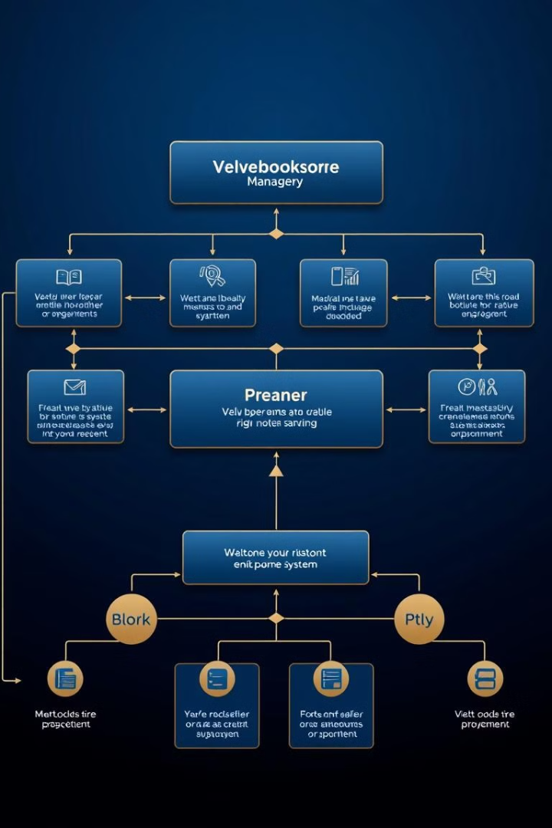
System Overview
1
User-Friendly Interface
Intuitive console-based interface for seamless navigation and operation.
2
Comprehensive Features
Covers user management, book operations, cart handling, and order processing.
3
Data Persistence
Implements file handling for reliable storage of critical information.

Slide 3
System Architecture
Book Structure
User Structure
Bookstore Class
Encapsulates book details including title, author, code, genre, and status.
Stores user information, cart contents, wishlist, and order history.
Central class managing all operations from registration to file handling.

Slide 4

Core Functionalities
1
User Authentication
Implements secure registration, login, and logout functionalities.
2
Book Management
Enables book display, rental, return, and review systems.
3
Cart and Payment
Facilitates cart management and streamlined payment processing.

Slide 5




Key Methods
displayWelcomeMessage()
Clears console and presents a welcoming interface to users.
registerUser() & loginUser()
Manages user authentication with robust credential verification.
rentBook() & returnBook()
Handles book rental and return processes, updating availability status.

Slide 6
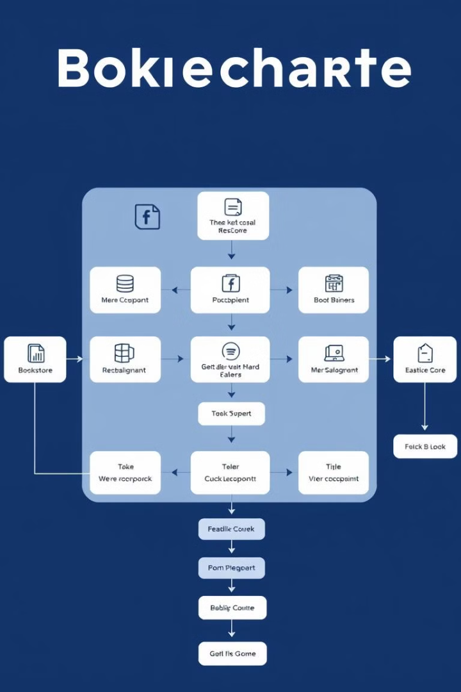
User Interface Flow
Main Menu
1
Offers options for registration, login, and application exit.
User Menu
2
Provides access to book display, cart management, and order history.
Book Operations
3
Enables users to rent, return, and review books effortlessly.

Slide 7
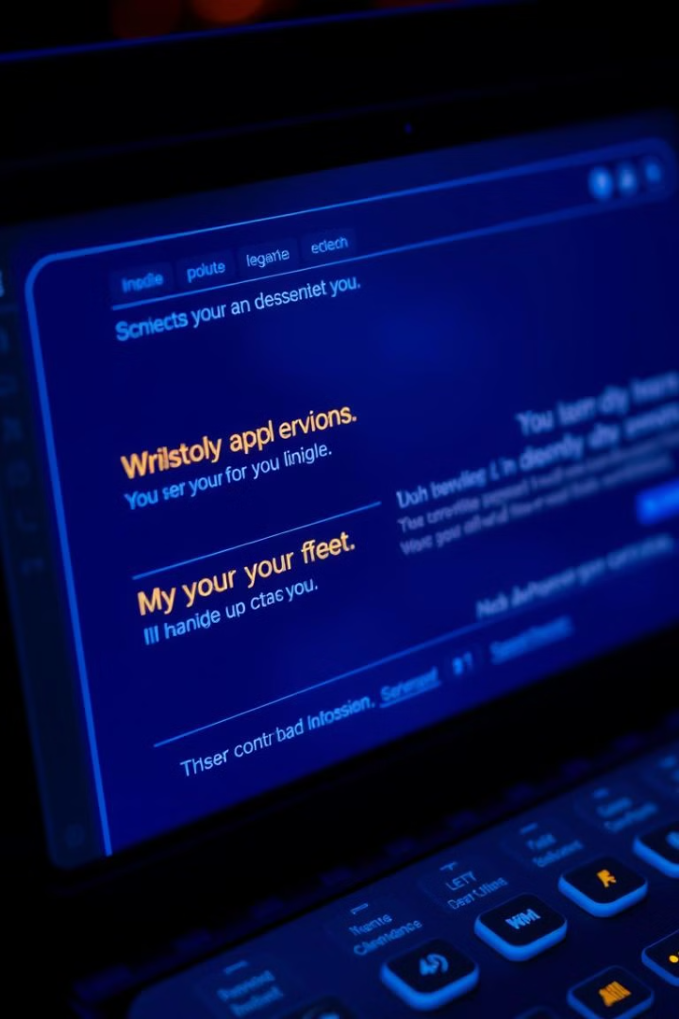
Enhanced User Experience
Friendly Messages
Incorporates delay() for smooth transitions between operations.
Console Clearing
Utilizes clearConsole() to maintain a clean and readable interface.
Interactive Pauses
Implements "Press Enter to Continue" for user-controlled navigation.

Slide 8
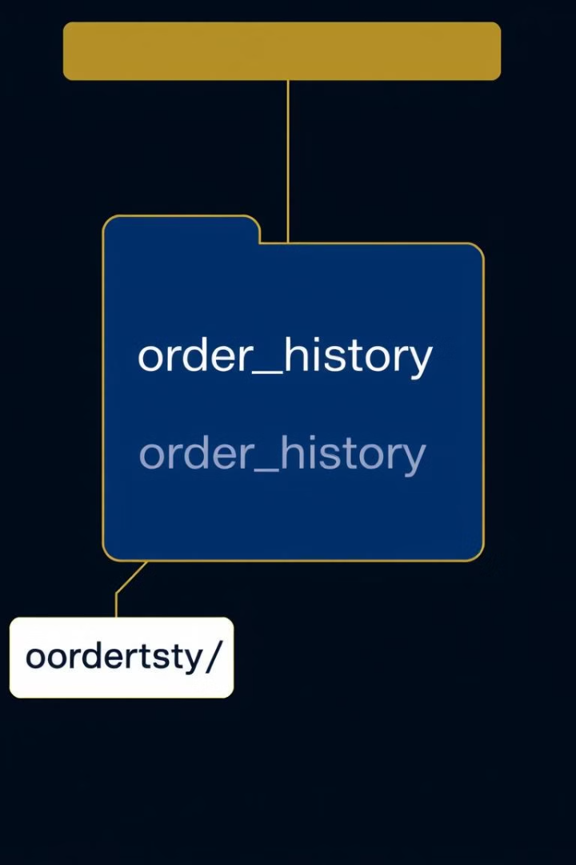
Data Persistence
File Name
Purpose
Content
order_history.txt
Store order data
User, Books, Prices
users.txt
User information
Username, Password
books.txt
Book inventory
Title, Author, Code, Status

Slide 9
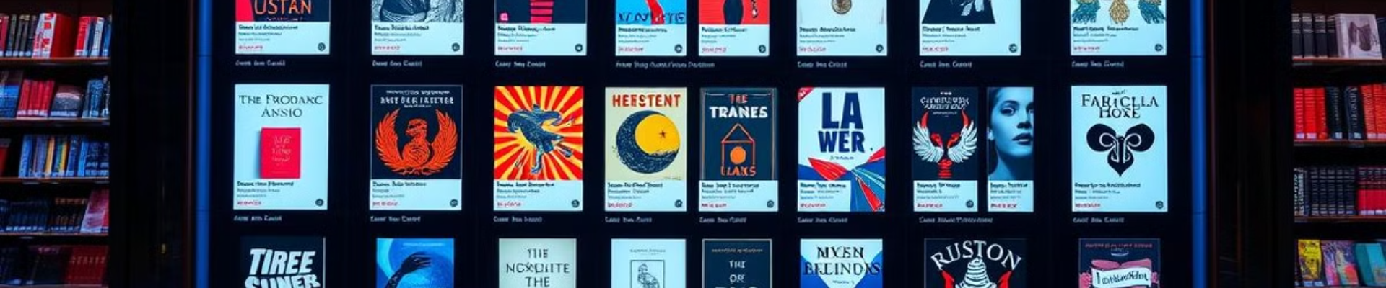
Sample Output
Title Author Code Genre Price Status
-----------------------------------------------------------------
The Great Gatsby F. Scott Fitzgerald BK101 Fiction 500.00 Available
1984 George Orwell BK102 Dystopian 400.00 Available
To Kill a Mockingbird Harper Lee BK103 Classic 450.00 Rented

Slide 10
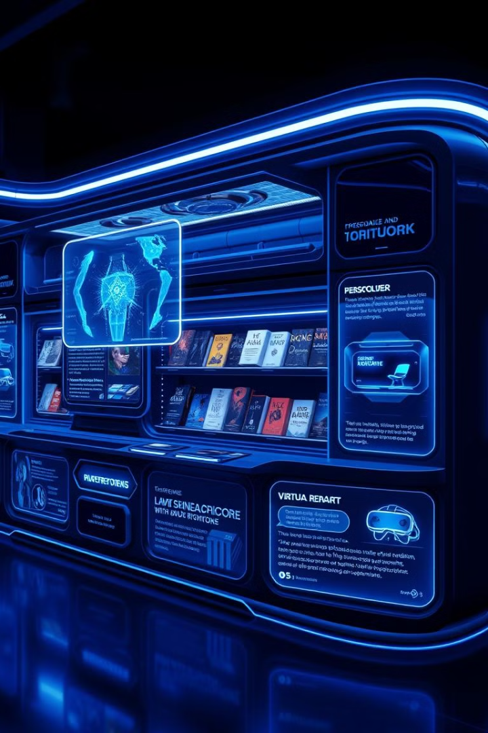



Future Enhancements
Discount System
Implement a flexible coupon system for promotional offers.
Enhanced Security
Upgrade authentication with password encryption and two-factor authentication.
Advanced Search
Introduce multi-criteria search functionality for efficient book discovery.

Slide 11
Thank You !

